Slide 1
Lecture Notes – BSCS 5th Semester Course: Digital Image Processing Instructor: Adnan Majeed Topic: Fourier Theory

Slide 2
1. Introduction
Fourier Theory is a cornerstone of signal and image processing. It allows us to represent any signal (or image) as a sum of sinusoidal functions (sines and cosines).
In digital image processing, Fourier Transform (FT) is used to analyze the frequency content of images.
It is essential for filtering, compression, image enhancement, and reconstruction.

Slide 3
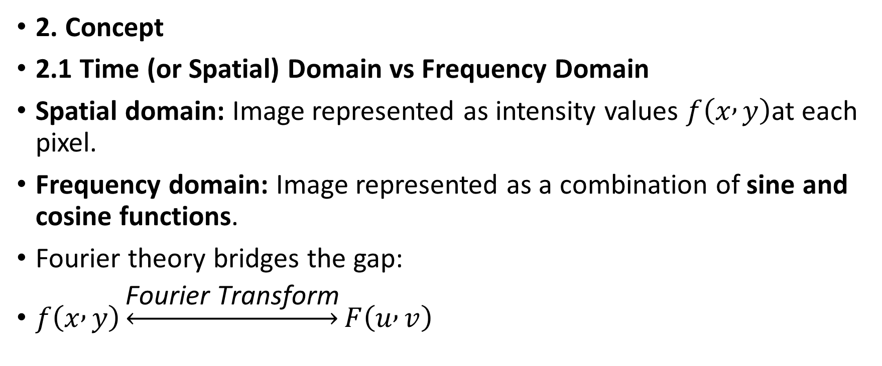
2. Concept
2.1 Time (or Spatial) Domain vs Frequency Domain
Spatial domain: Image represented as intensity values $f\left(x , y\right)$at each pixel.
Frequency domain: Image represented as a combination of sine and cosine functions.
Fourier theory bridges the gap:
$f\left(x , y\right)\underset{↔}{\text{Fourier} \text{Transform}}F\left(u , v\right)$

Slide 4

Where:
$f\left(x , y\right)$= spatial domain image
$F\left(u , v\right)$= frequency domain representation

Slide 5
2.2 Why Fourier Theory?
Detect periodic patterns in images
Filter noise using high-pass or low-pass filters
Compress images efficiently
Analyze edges and textures

Slide 6
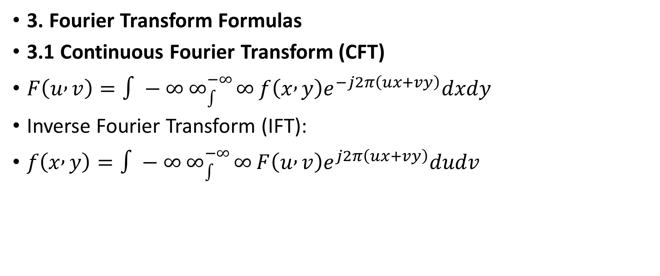
3. Fourier Transform Formulas
3.1 Continuous Fourier Transform (CFT)
$F\left(u , v\right)=∫−∞∞_{∫}^{−∞}{∞}f\left(x , y\right)e^{−j2π\left(ux+vy\right)}dxdy$
Inverse Fourier Transform (IFT):
$f\left(x , y\right)=∫−∞∞_{∫}^{−∞}{∞}F\left(u , v\right)e^{j2π\left(ux+vy\right)}dudv$

Slide 7
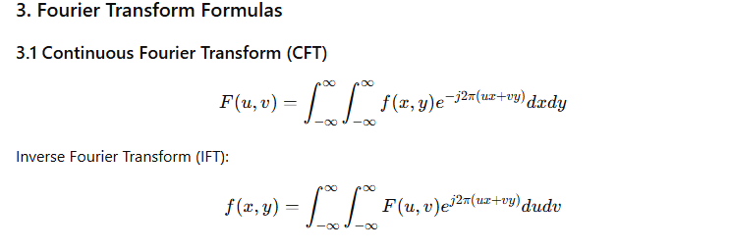
3.2 Discrete Fourier Transform (DFT)
For digital images (size M×N):
Inverse DFT:

Slide 8
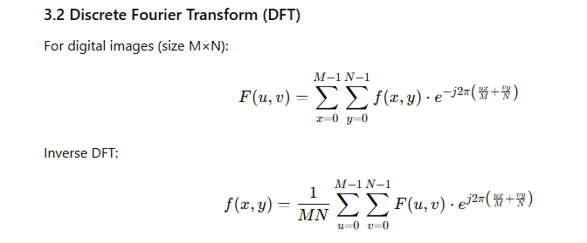

Slide 9

3.3 Fast Fourier Transform (FFT)
Efficient algorithm to compute DFT.
Reduces computation from $O\left(N^{2}\right)$to $O\left(N\log{N}\right)$.
Widely used in digital image processing software.

Slide 10
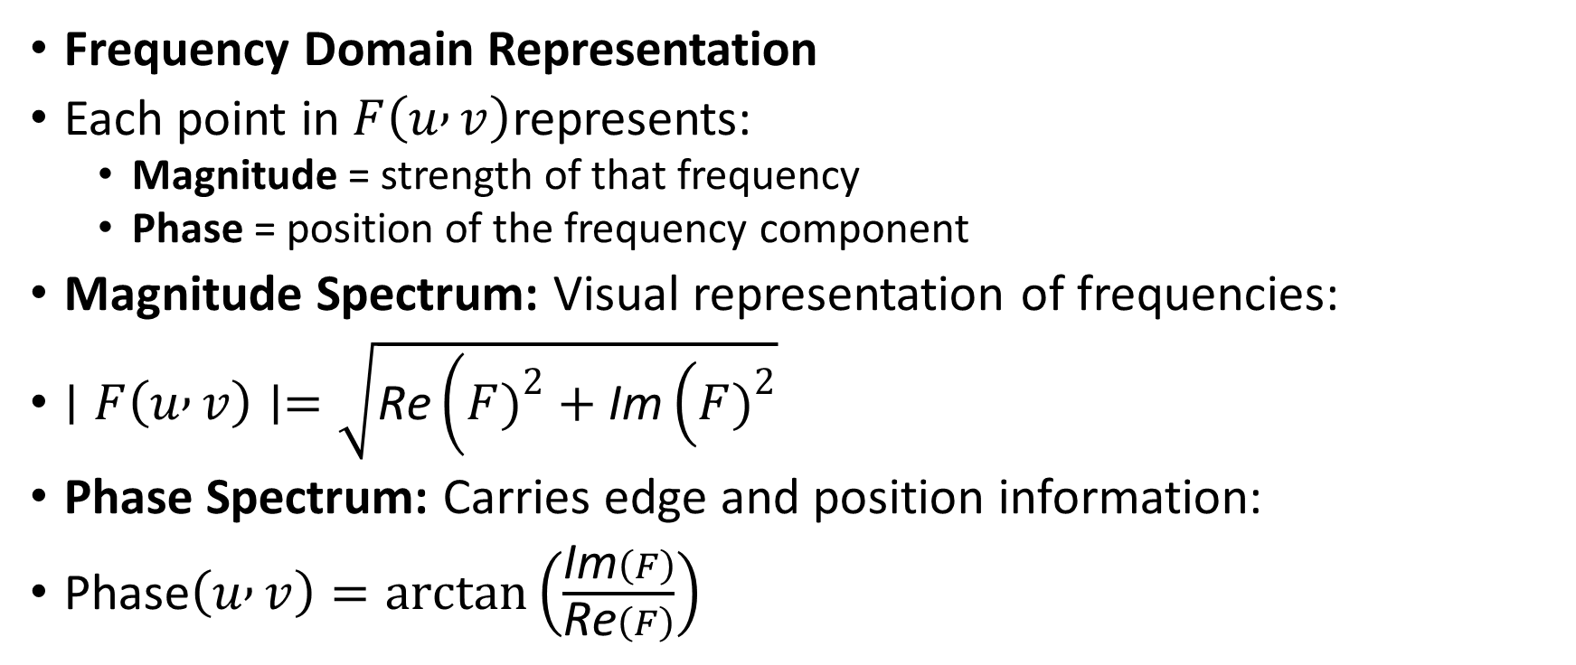
Frequency Domain Representation
Each point in $F\left(u , v\right)$represents:
Magnitude = strength of that frequency
Phase = position of the frequency component
Magnitude Spectrum: Visual representation of frequencies:
$∣F\left(u , v\right)∣=\sqrt{\text{Re}\left(F{\left.)\right.}^{2}+\text{Im}\left(F{\left.)\right.}^{2}\right.\right.}$
Phase Spectrum: Carries edge and position information:
$\text{Phase}\left(u , v\right)=\arctan\left(\frac{\text{Im}\left(F\right)}{\text{Re}\left(F\right)}\right)$

Slide 11
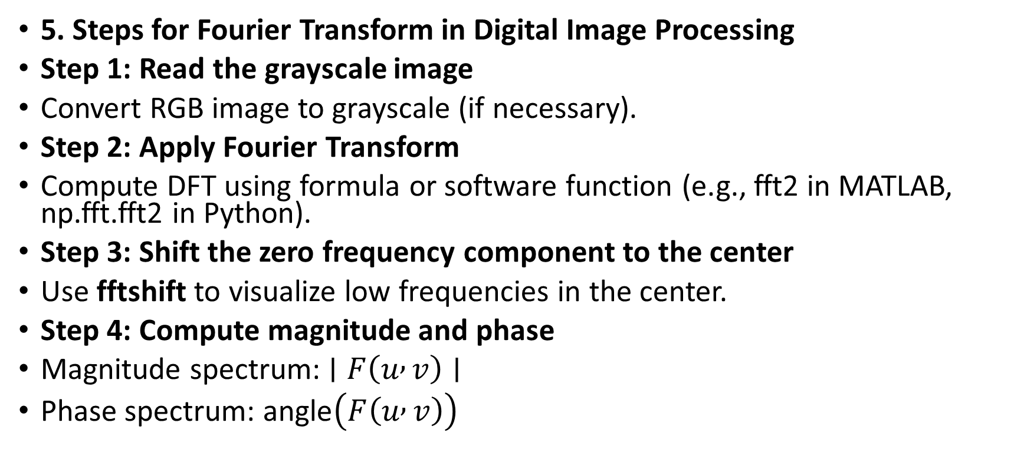
5. Steps for Fourier Transform in Digital Image Processing
Step 1: Read the grayscale image
Convert RGB image to grayscale (if necessary).
Step 2: Apply Fourier Transform
Compute DFT using formula or software function (e.g., fft2 in MATLAB, np.fft.fft2 in Python).
Step 3: Shift the zero frequency component to the center
Use fftshift to visualize low frequencies in the center.
Step 4: Compute magnitude and phase
Magnitude spectrum: $∣F\left(u , v\right)∣$
Phase spectrum: $\text{angle}\left(F\left(u , v\right)\right)$

Slide 12
Step 5: Apply filters (optional)
Low-pass filter (smooths image, removes high-frequency noise)
High-pass filter (enhances edges, removes low-frequency background)
Step 6: Apply Inverse Fourier Transform
Recover spatial domain image from frequency domain using IFFT (ifft2).

Slide 13
Example in Python
import cv2
import numpy as np
from matplotlib import pyplot as plt
# Step 1: Load grayscale image
img = cv2.imread('input.jpg', 0)
# Step 2: Compute FFT
f = np.fft.fft2(img)
fshift = np.fft.fftshift(f)
# Step 3: Magnitude Spectrum
magnitude_spectrum = 20*np.log(np.abs(fshift))

Slide 14
# Step 4: Display
plt.subplot(121), plt.imshow(img, cmap='gray')
plt.title('Original Image')
plt.subplot(122), plt.imshow(magnitude_spectrum, cmap='gray')
plt.title('Magnitude Spectrum')
plt.show()

Slide 15
7. Applications of Fourier Theory in Image Processing
Image Filtering: Low-pass, high-pass, band-pass filters.
Image Compression: JPEG uses Discrete Cosine Transform (DCT) (related to Fourier Transform).
Edge Detection: Using high-pass filtering in frequency domain.
Pattern Recognition: Analyze frequency components for repetitive patterns.
Image Restoration: Remove periodic noise in images.

Slide 16
8. Advantages of Fourier Analysis
Provides global frequency information
Useful for linear filtering
Can analyze periodic patterns and texture

Slide 17
9. Limitations
Phase information is critical for reconstruction; losing phase can distort the image.
High computation for large images (addressed using FFT).
Not suitable for localized features, for which Wavelet Transform is preferred.

Slide 18
10. Lab/Assignment Tasks
Task 1: Compute the Fourier Transform of a grayscale image and display magnitude and phase spectrum.
Task 2: Apply low-pass and high-pass filters in frequency domain and observe results.
Task 3: Reconstruct the original image using inverse FFT and compare with the input image.

Slide 19
Summary Table
Concept | Key Point
Fourier Transform | Converts spatial domain to frequency domain
DFT | Discrete version for digital images
FFT | Fast algorithm for DFT
Magnitude | Strength of frequency component
Phase | Position information of frequency
Applications | Filtering, compression, edge detection, noise removal

